Slide 1

Library Manager

Slide 2

Dr. Amrita Chaturvedi

Slide 3

Vishal Kumar Singh IIT2015141
Ayush Agnihotri IIM2015004
Nidheesh Pandey IIM2015501
Abhishek Pasi ICM2015002
Shreyansh Gupta IIM2015001

Slide 4

Library Manager is a application to maintain records related to Book Issue, Book Search, Book Returns, Book reissue, adding member and all necessary requirements for the Library to manage day to day operations.
The main objective of the application is to automate the existing system of manually maintaining the records of Book Issue, Book return from the member, Book Search to be computerized. So the book issue, return, searching will be faster. This application can be used by any Library to automate the process of manually maintaining the records related to the subject of maintaining books & member records.
This application allows user to add data about the book and details of the members issuing the books. It allows user to fetch data about currently issued books . It allows user to issue, reissue, return book(s).The GUI of application is user friendly for easy to use experience of user.

Slide 5

Java FX
Apache Derby (Database)
Jfoenix(open source GUI library)
The project is created and tested on Netbeans 8.2.

Slide 6

E R Diagram
Database Schema
Normalization Diagrams
State Chart Diagram
Activity Diagram

Slide 7

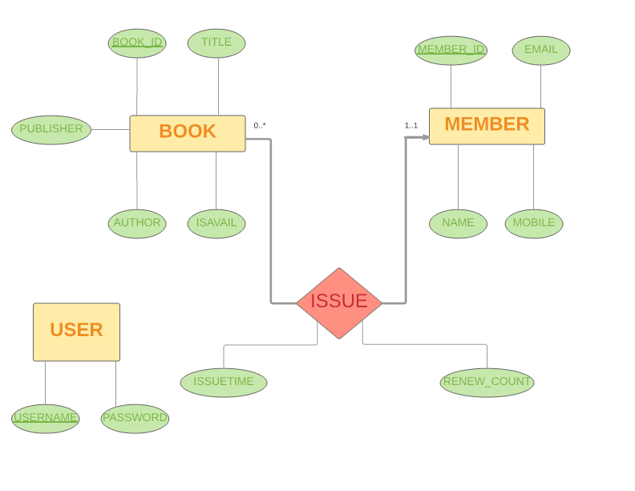
BACK

Slide 8


Slide 9

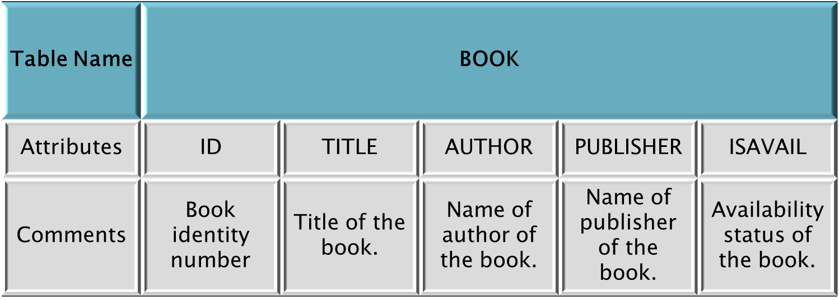

Slide 10

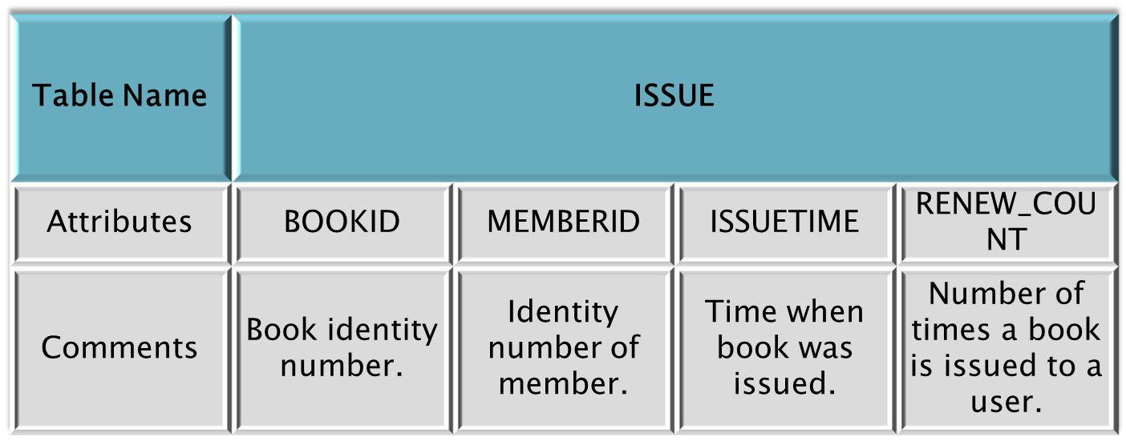

Slide 11
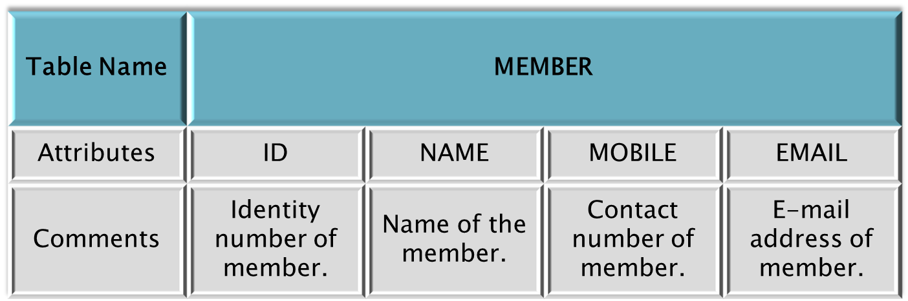

Slide 12
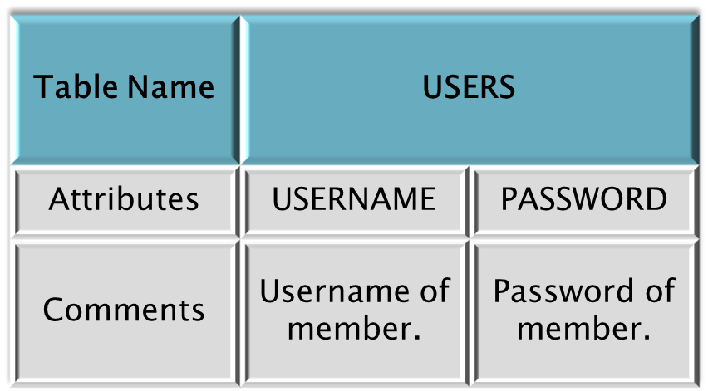
BACK

Slide 13


Slide 14

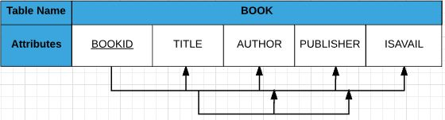
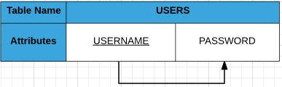
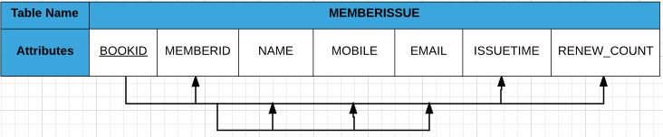

Slide 15

Criteria
  All attributes must be single-valued
  All values in a column must contain values of the same domain
  The order of rows & order of columns is irrelevant
  No two columns should have same name
  There must be no composite attributes
Test
  Evidently, all attributes are single-valued
  No attributes are composite
  All conditions for 1NF are satisfied
Changes
  No changes required
  Table is already in 1st Normal Form

Slide 16


Slide 17

Criteria
  It should be in 1NF
  Non-Key attributes should be Functionally Dependent on Key attributes
  If Primary Key is Composite, no Non-Key attribute should be Partially Dependent on any part of the Primary Key
Test
  All Non-Key attributes are implicitly dependent on the Primary Key attribute
  Question of Partial Dependency is ruled out since there are no Composite Primary Keys
Changes
  No changes required
  Table is already in 2nd Normal Form

Slide 18


Slide 19

Criteria
  It should be in 2NF
  No Non-Key attributes should be Functionally Dependent on any Non-Key attribute, i.e., attributes must not have Transitive Dependency on Primary Key
Test
  USERS table satisfy the criteria whereas other two tables do not satisfy.
  In Book table, Publisher & Author attributes are dependent on Title i.e. Transitive Dependency.
  In MemberIssue table, Name, Mobile, E-Mail attributes are dependent on MemberID i.e. Transitive Dependency
Changes
  No changes required in USERS table
  Table BOOK decomposed into two tables BOOK1 and BOOK2
  Table MEMBERISSUE decomposed into two tables MEMBER and ISSUE

Slide 20
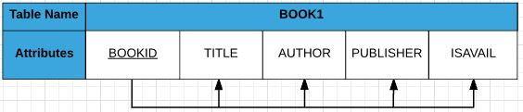
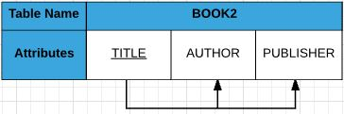
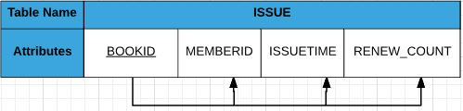
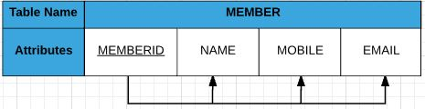

Slide 21

Criteria
  It should be in 3NF
A relational schema R is in Boyce–Codd normal form if and only if for every one of its dependencies X → Y,
X is a super key for schema R
Test
  All tables satisfy the criteria for Boyce-Codd Normal Form
Changes
  No changes required
  Table is already in Boyce-Codd Normal Form

Slide 22

BACK

Slide 23

Back

Slide 24
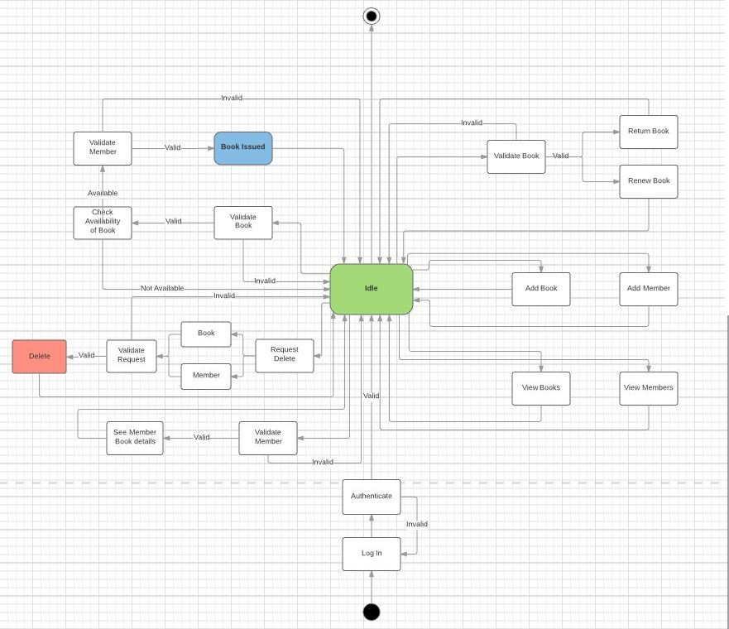

Online Voting System

Slide 25


Slide 26
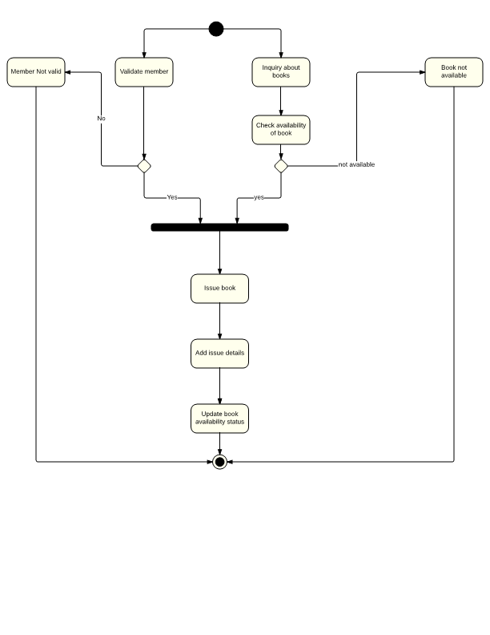
Online Voting System

Slide 27
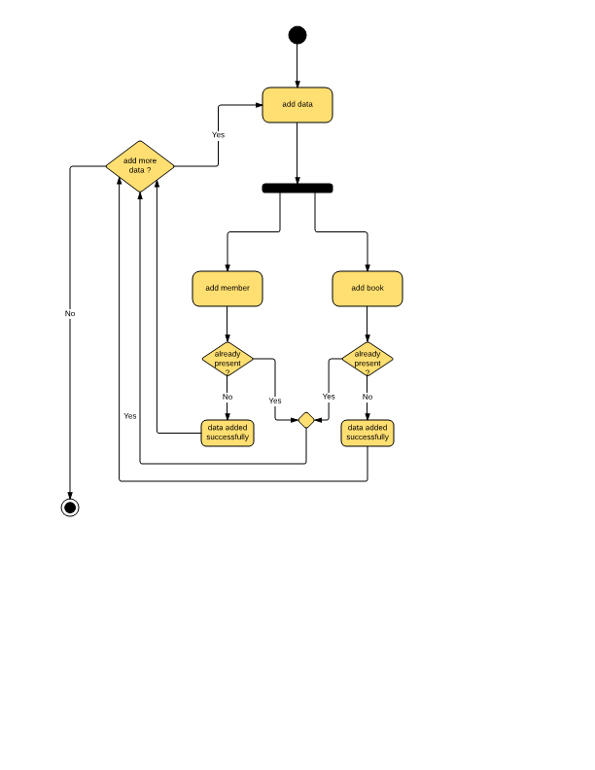
Online Voting System

Slide 28
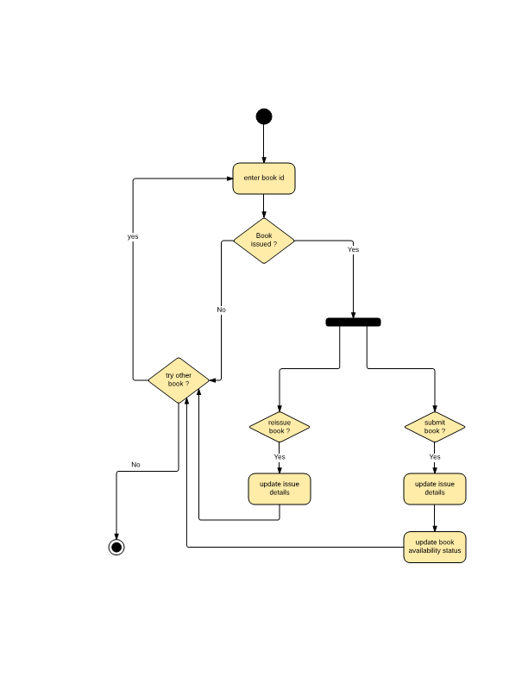
Online Voting System

Slide 29
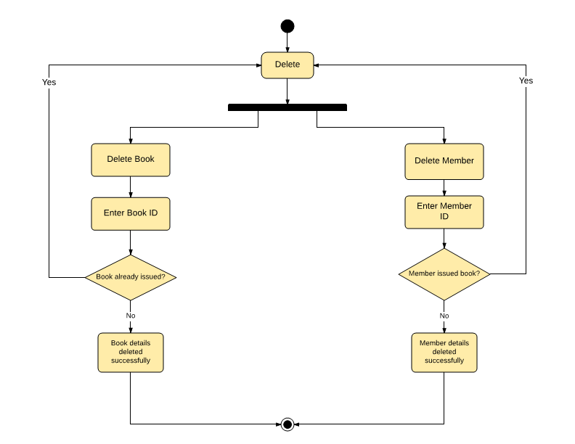

Slide 30
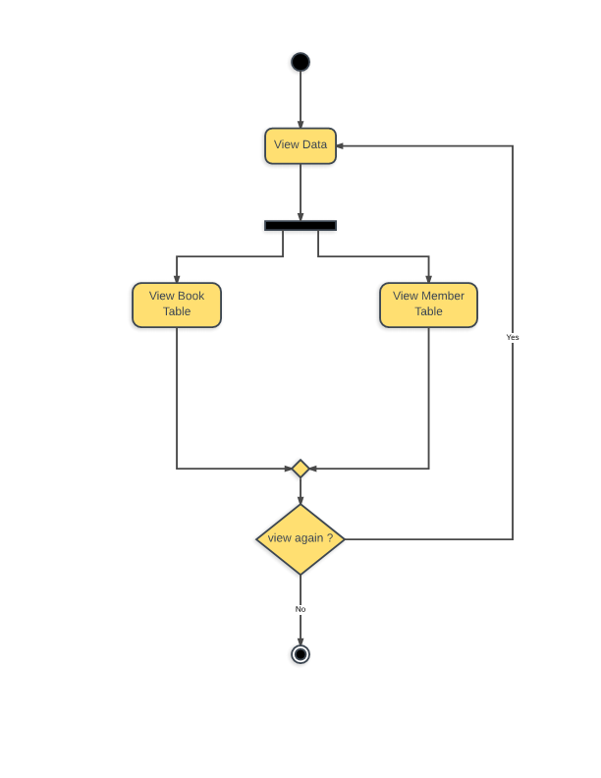
BACK
Online Voting System

Slide 31
Thank You

